Slide 1
Étlap Website
Created by: 13.D Szoftver vegyes
Buda Levente István
Ócsai Márk
Surmann Márk

Slide 2
Introduction
Mit volt a cél és milyen lett (Why, What)
Projekt részei, működése és eszközök (hogyan csináltuk meg, How)
Munkamegosztás

Slide 3
Project aim
An easy-to-use, responsive, full-stack website, where orders can be placed and picked up on the spot.

Slide 4
Website idea
The idea of the website is to fix and simplify the many difficult-to-use websites that are developed by restaurants.

Slide 5
Target audience
For people who want to order efficiently and easily
For restaurants that do not have a website that meets their needs.

Slide 6
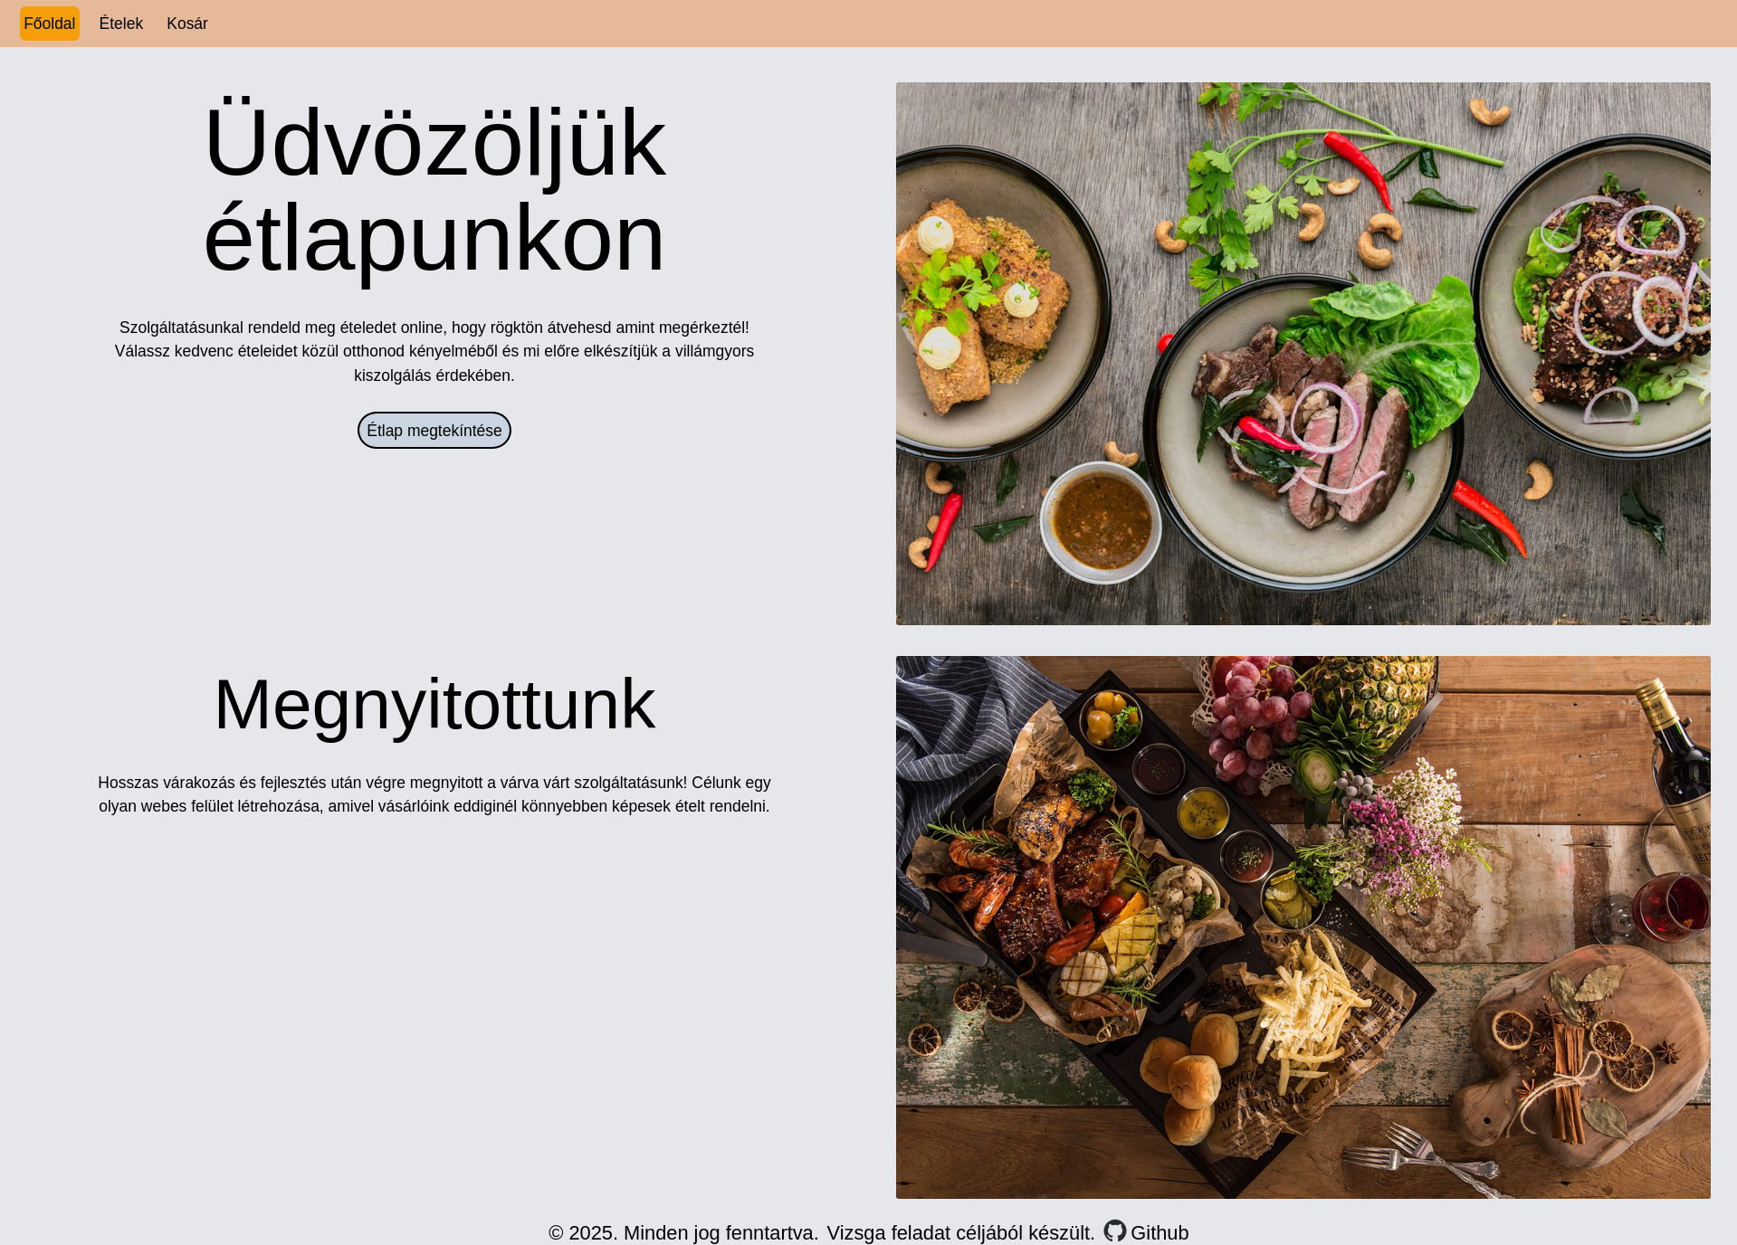
Result

Slide 7
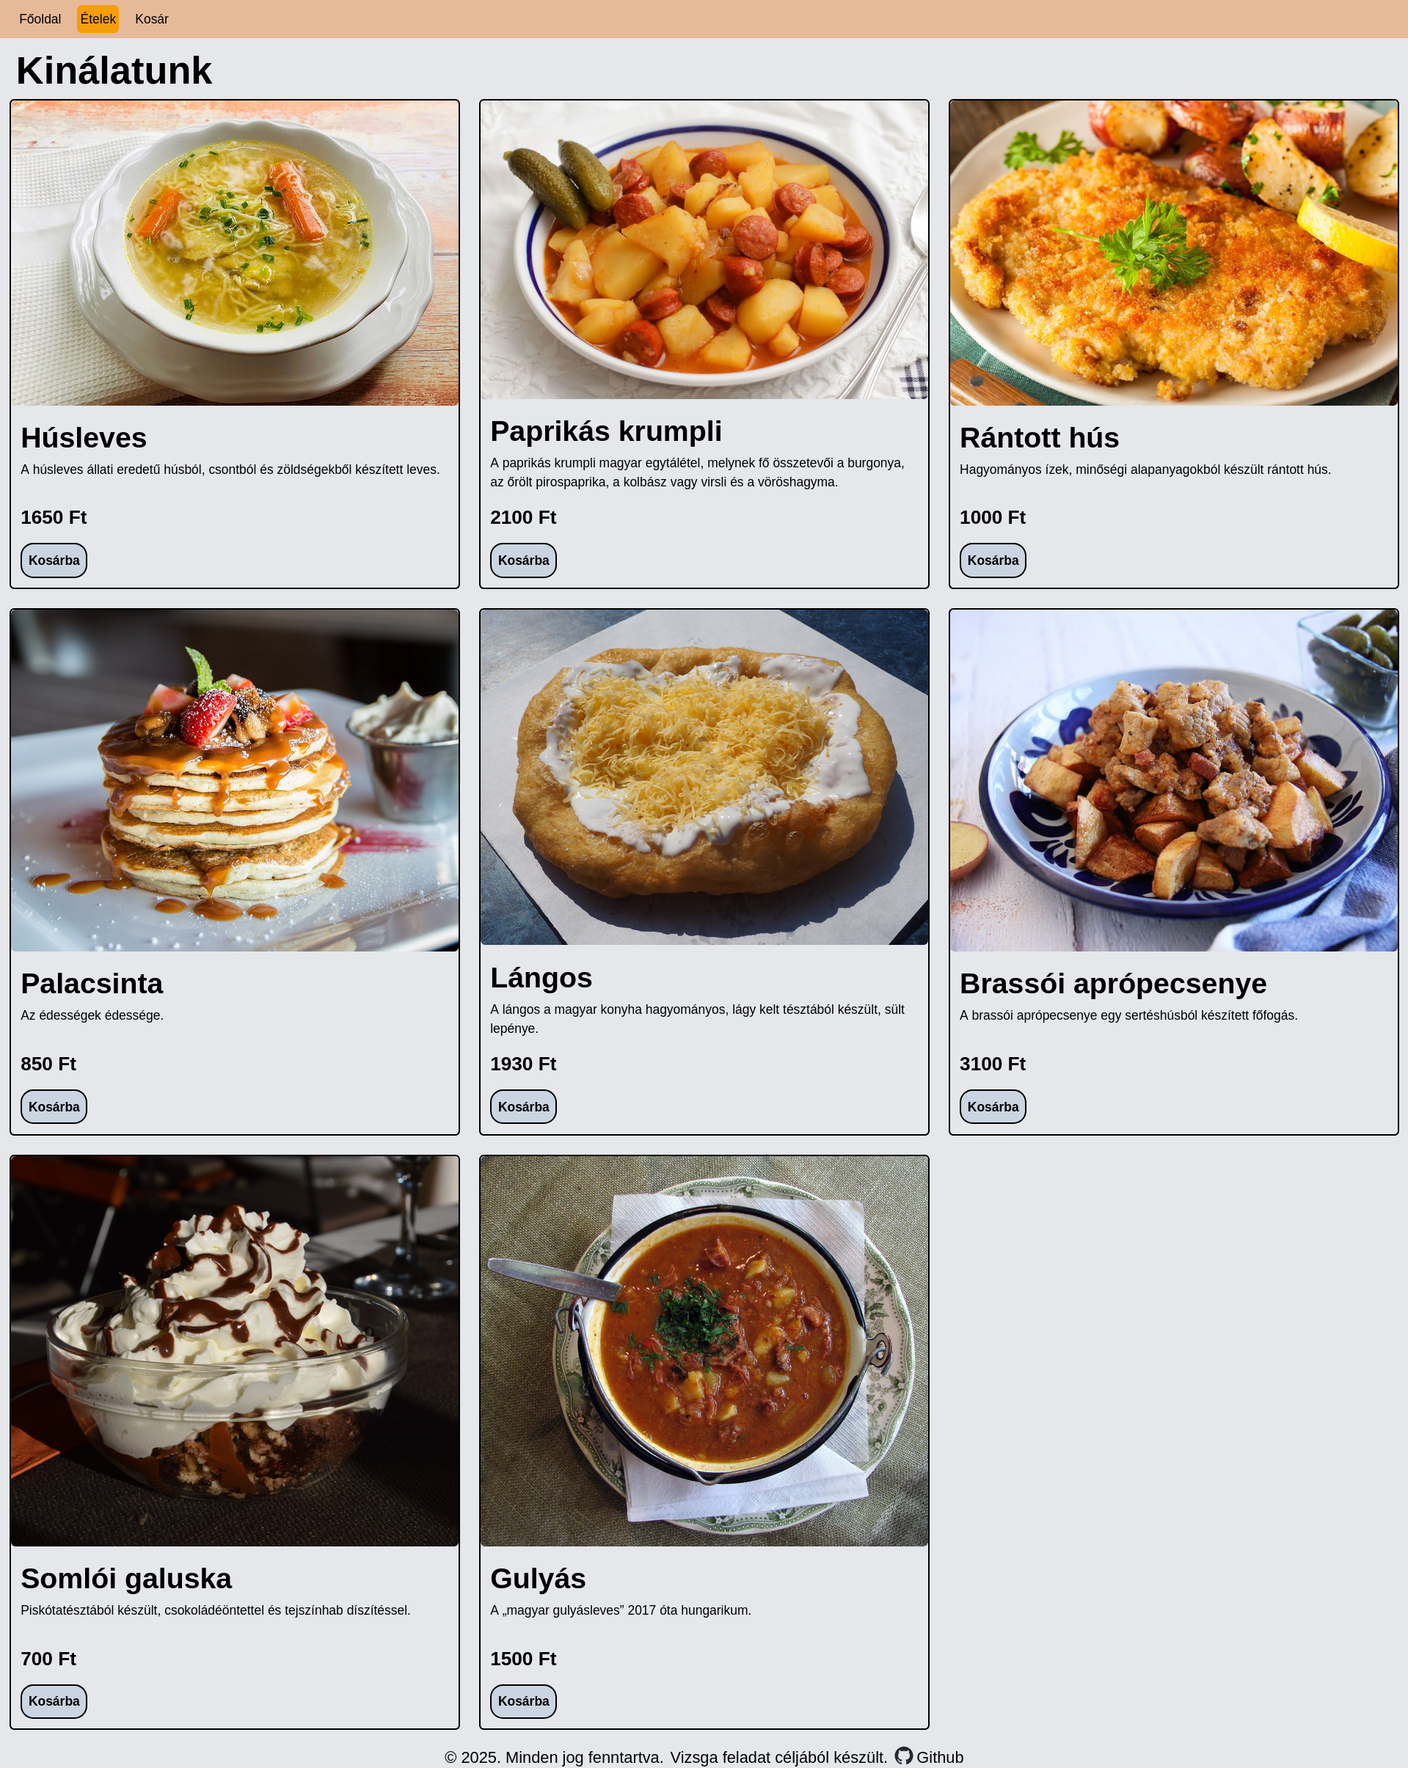

Slide 8
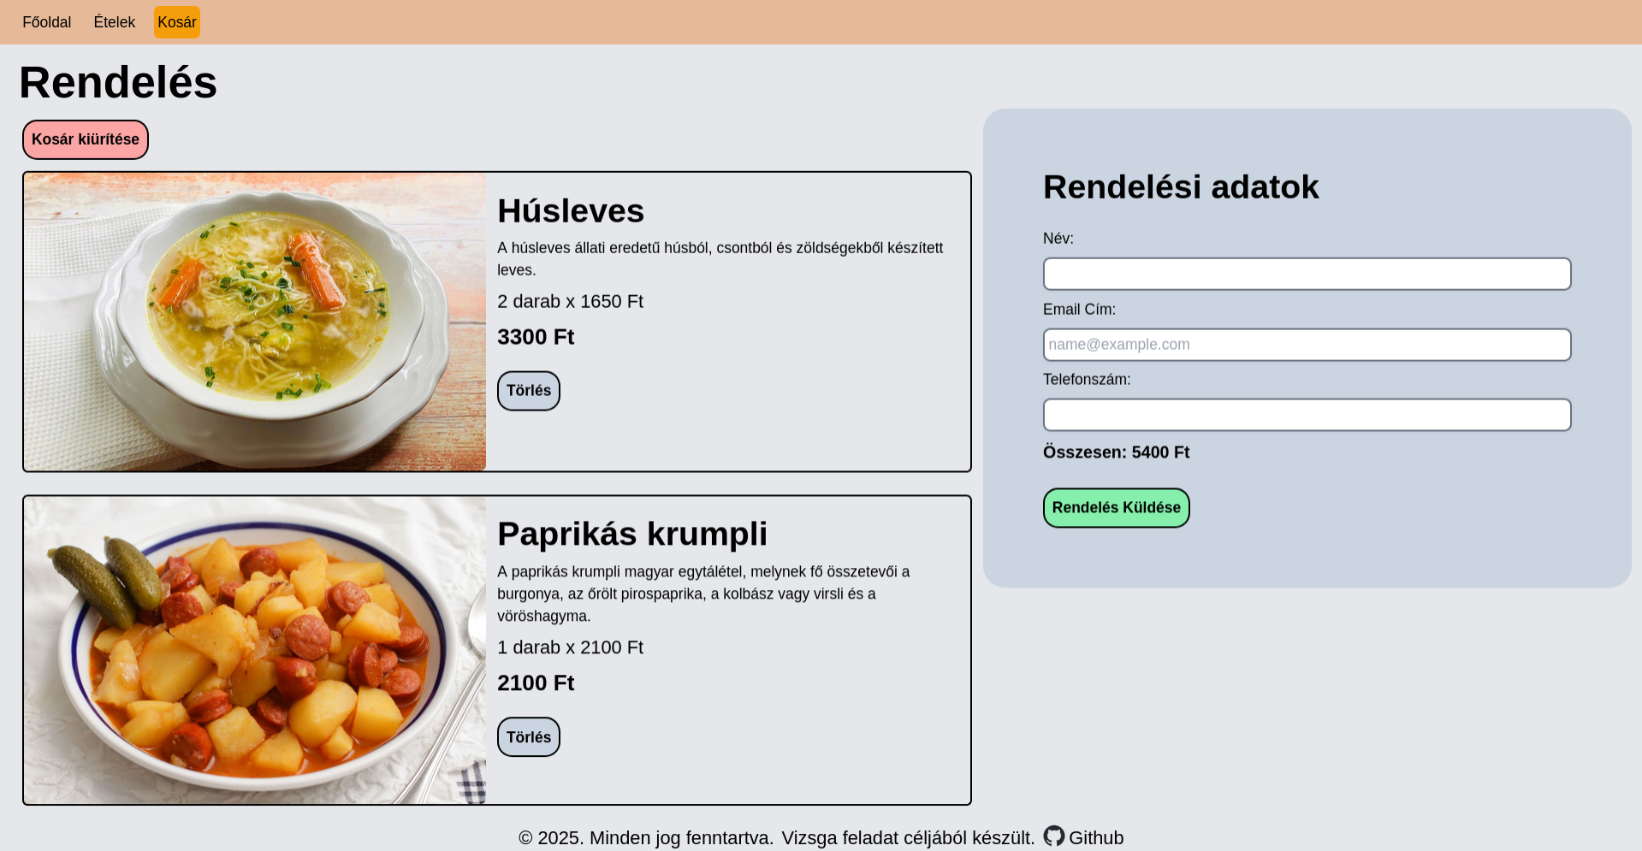

Slide 9
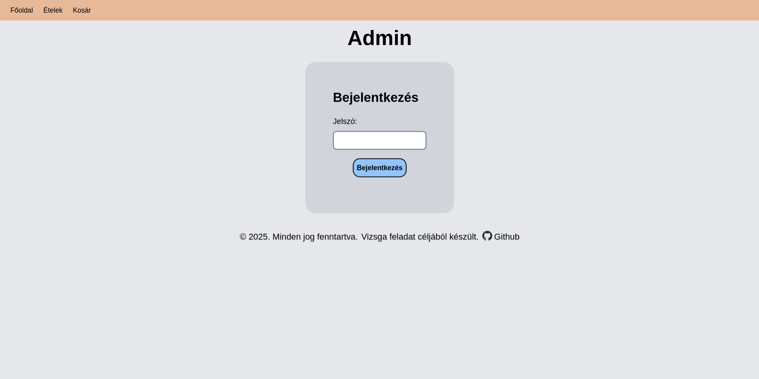

Slide 10
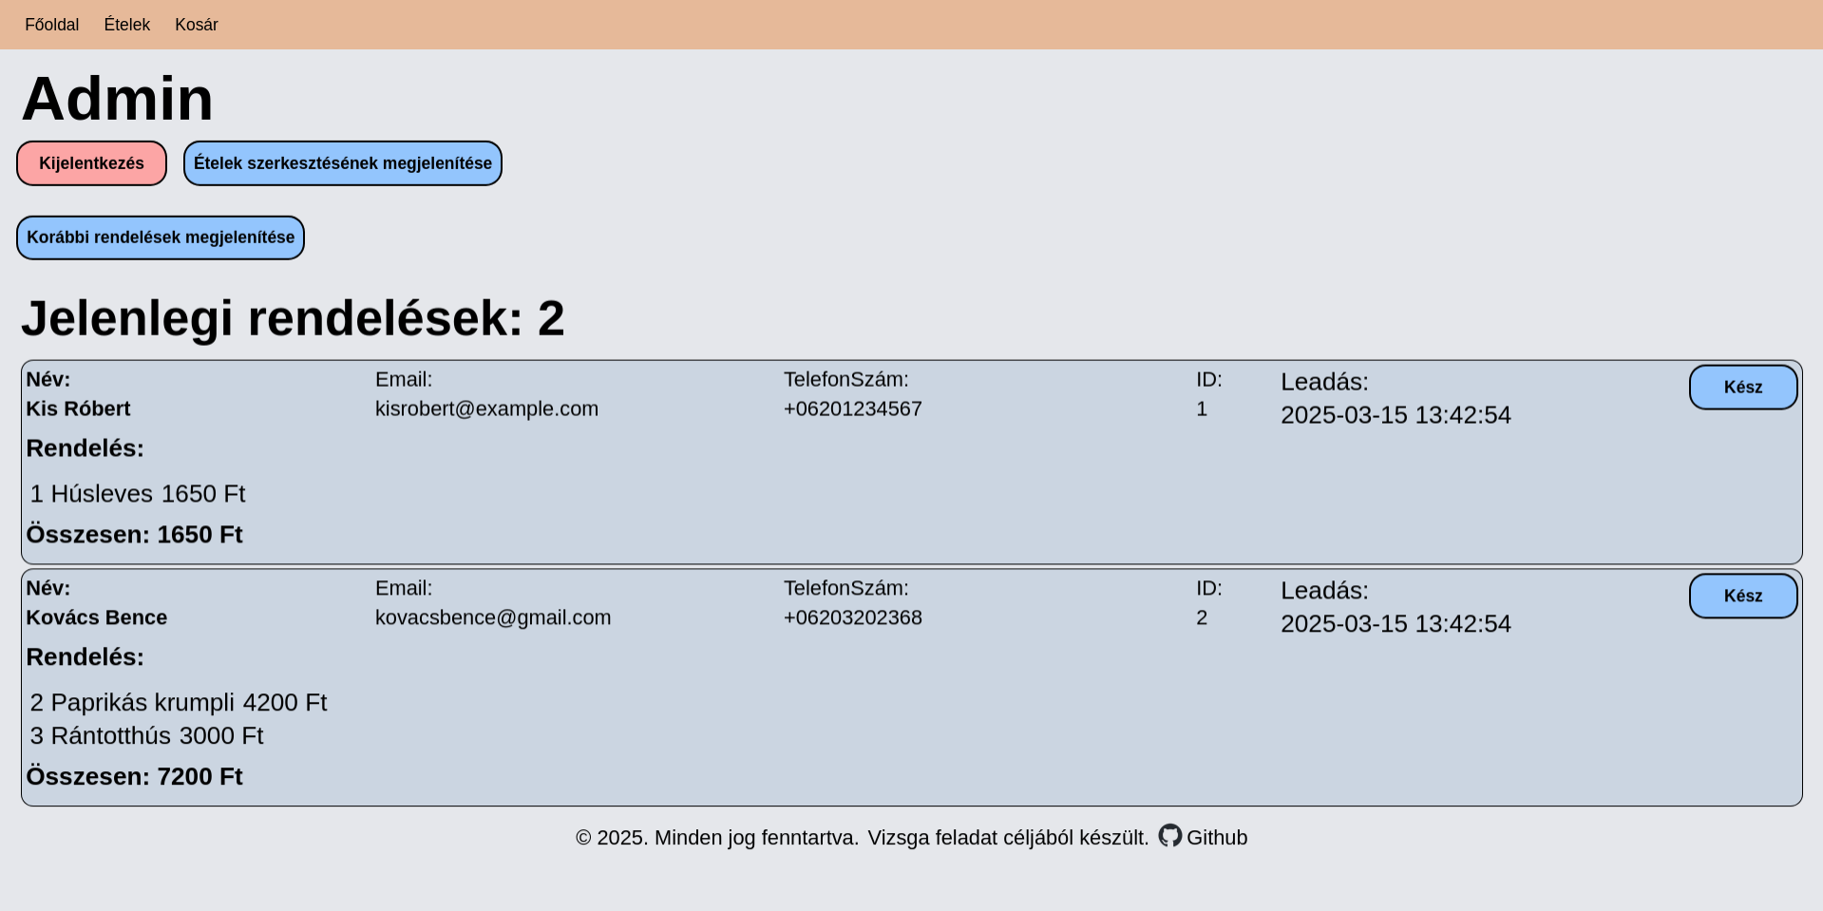

Slide 11
Tools used
Frontend / Website
HTML CSS JavaScript
Tailwind: CSS framework
Vue.js: JavaScript framework
Backend / RESTful API
Go programming language
Gin: HTTP web framework
Database
MySQL or MariaDB

Slide 12
Version Control
Git
GitHub
Text Editor
Visual Studio Code
GNU Emacs
Operating System
Microsoft Windows 10
Gentoo GNU/Linux
Testing
VSCode REST Client

Slide 13
Project Structure
Focus on Simplicity & Efficiency
3 main parts:
Website
RESTful API
Database

Slide 14
Website
Single page application (SPA) written in Vue.js
3 main parts:
index.html, main.ts (initialization)
App.vue
Components

Slide 15
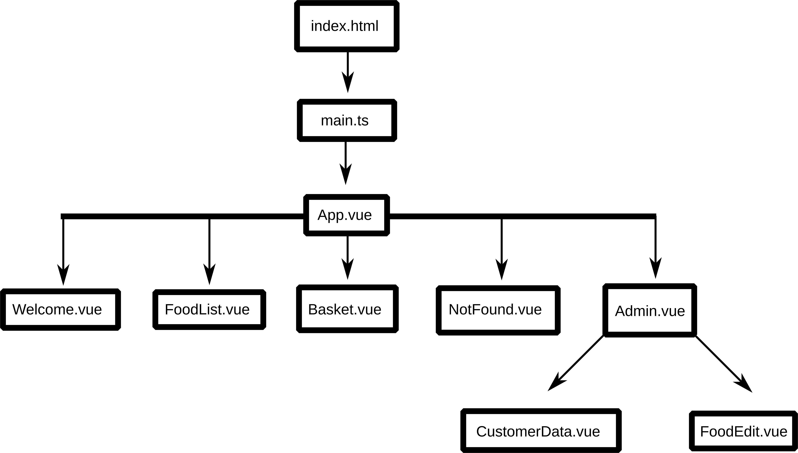

Slide 16
RESTful API
RESTful API written in Go
2 main parts:
main.go
Restapi package

Slide 17
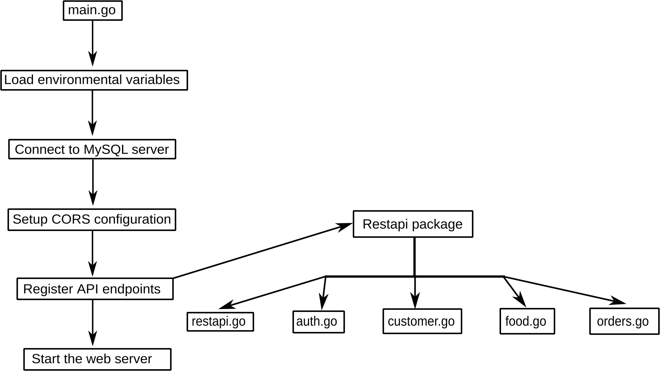

Slide 18
Database
MySQL or MariaDB SQL database
3 main parts:
Customers table
Foods table
Orders table

Slide 19
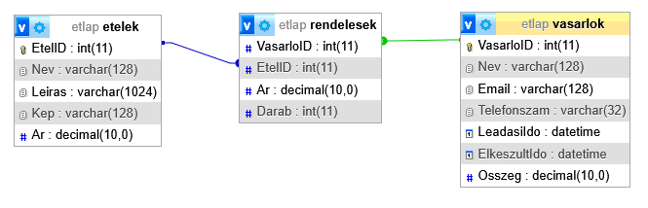

Slide 20

Project architecture

Slide 21
Team Work
Buda Levente István 25%
Ócsai Márk 25%
Team Leader: Surmann Márk 50%

Slide 22
Tasks
Design: Everyone
Website
User: Surmann Márk
Admin: Buda Levente, Ócsai Márk
API: Surmann Márk
Database: Everyone
Testing: Buda Levente, Ócsai Márk

Slide 23
Thank you for your attention!

